Slide 1

REVISION
ENTITY RELATIONSHIP DIAGRAM EXERCISES
Prof Dr Melike Sah Direkoglu
Software Engineering, msah@ciu.edu.tr

Slide 2
ERD – Exercise 1
Draw an entity relationship diagram (ERD) with the instructions given below for a bank management system:
In a banking system, every bank has a name, code and address
A bank may have many branches. Every branch has branch_id, branch name, and branch address.
A branch may offer many loans. Every Loan entity must have loan_id and loan_type as well as amount.
A branch may manage many accounts. Every Account entity must have accountNo and AccountType as well as balance.
A loan is availed by Customer
An account is hold by by Customer
Every customer has customer_id, name, phone number, and customer's address information.

Slide 3
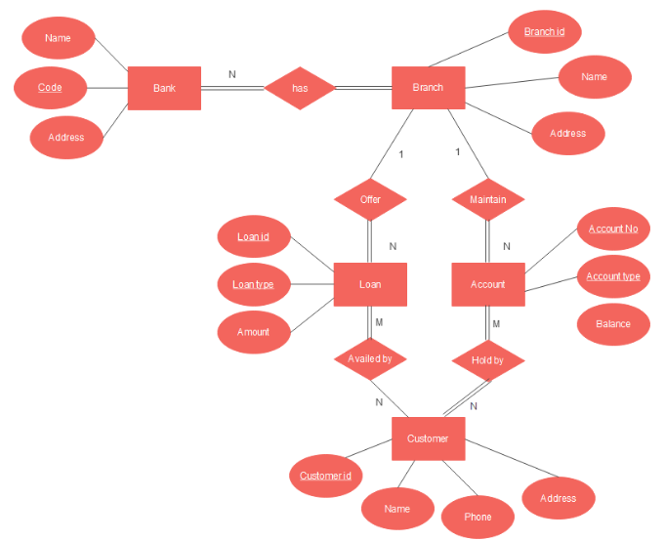

Slide 4
ERD – Exercise 2
Draw an ERD for the patient-doctor relationship. Details are given below:
Every patient has social security number, name, insurance, date of admission, date of checking out.
Patients may have Tests, where test includes test_id, test_name, test date, test time, test result.
Test is performed by Doctors. It is possible to perform many tests by many doctors.
Doctors have dss#, name, specialization.
Every patient has one associated doctor.

Slide 5
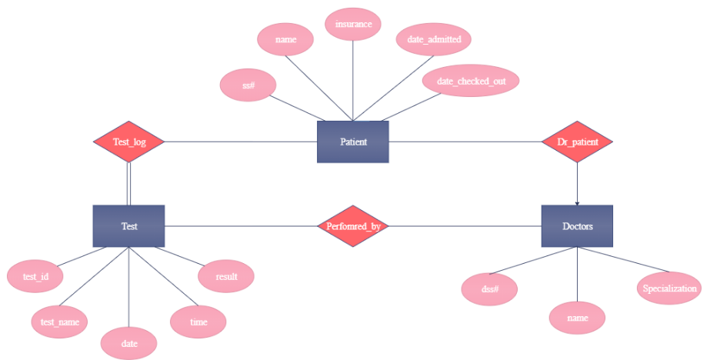

Slide 6
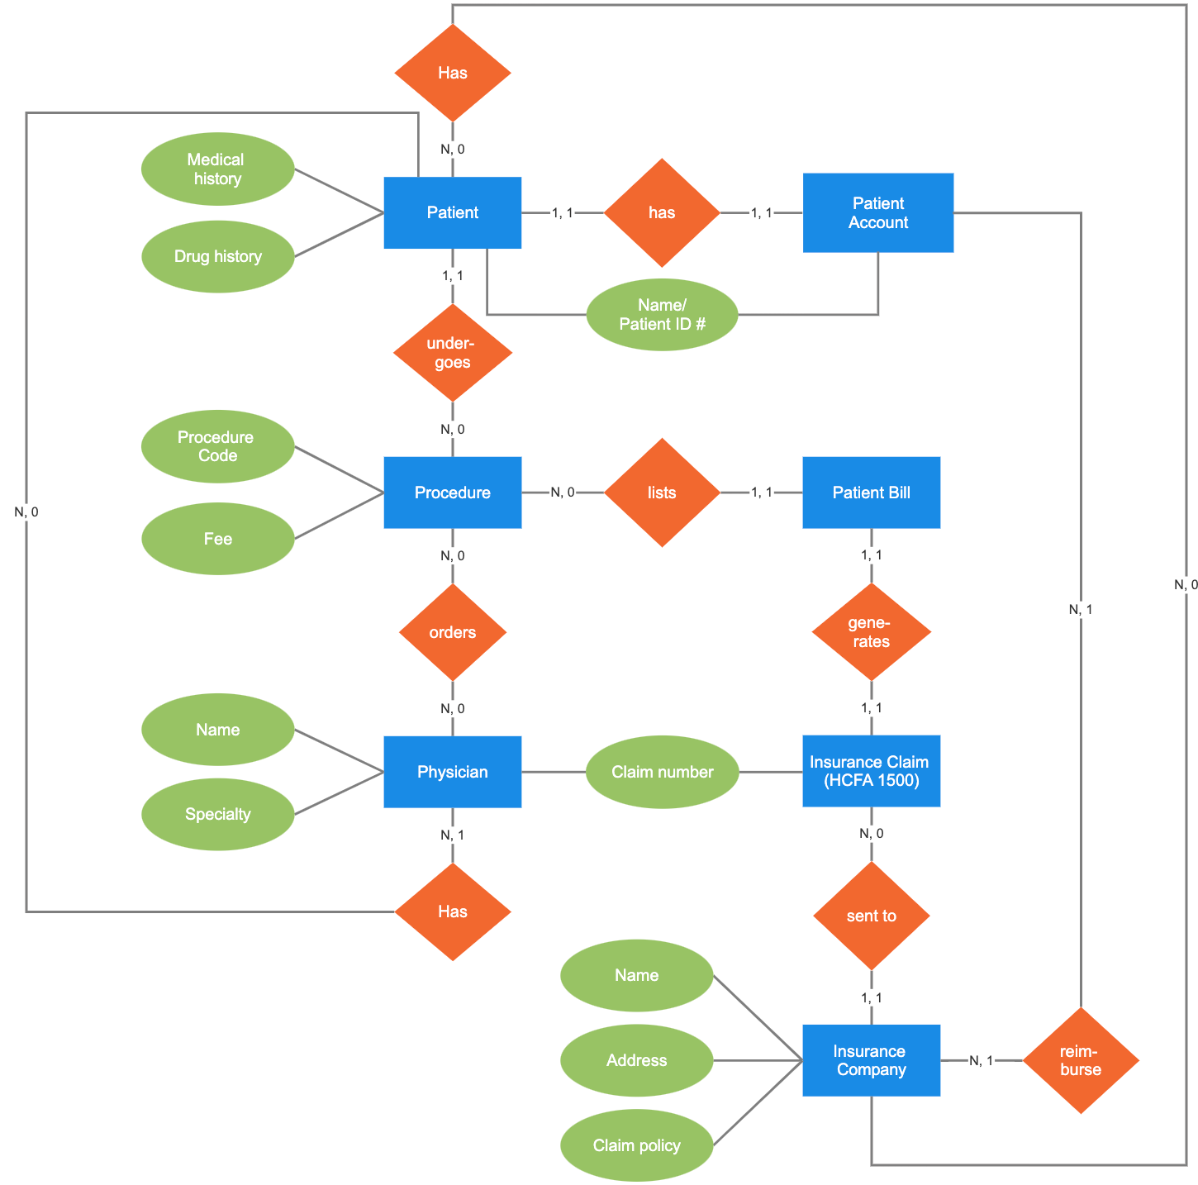
Another
Patient
ERD

Slide 7
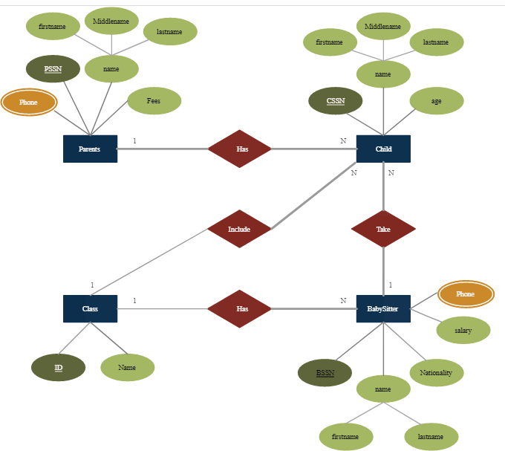

Child Care ERD

Slide 8
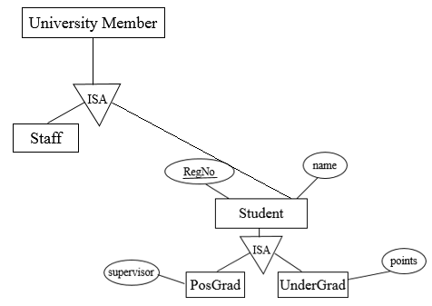
Extended ERD Example – University Members

Slide 9
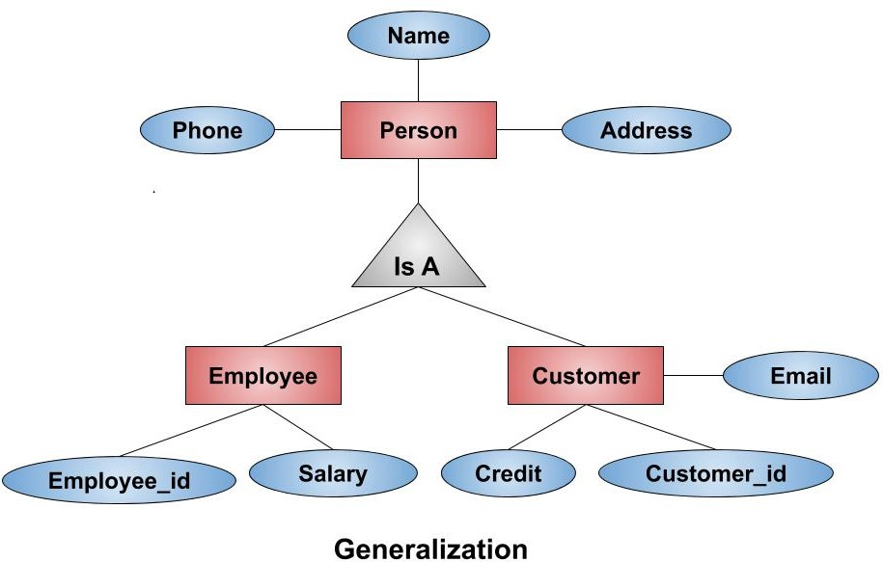
Extended ERD Example – Person

